Slide 1
P’ansori Today:
Contemporary Preservation and Innovation
Reinventing Culture in East Asia
EASIA 237

Slide 2
Today’s lecture
Resources overview (2)
Reading introduction: Writing a ‘reverse outline’ (3-4)
‘New P’ansori’ in the 20th century (5-6)
‘New P’ansori’ in the 21st century (7-8)
The ‘authenticity debate’ (9-11)
Quiz and Assignment details (12-13)

Slide 3
Resources overview:
P’ansori in Contemporary Korea
Videos
  ‘Outsider p’ansori’ Pak T’ae-O, “Star Wars”
    Based on PC game StarCraft. Excerpt in Um’s article.
  Seo Yoon Jang, Pansori 'Le Petit Prince', Episode: The Fox
    Based from The Little Prince. Written/performed after Um’s article.
    Same performer as ‘Korean Music 101’ videos from Unit 1.
    These are also “p’ansori today!”
  No subtitles/translation: Focus on performance, staging, etc.
Reading
  Um, Haekyung. “New P’ansori in Twenty-first-century Korea”
  Academic journal article.

Slide 4
New P’ansori in Twenty-first-century Korea: Creative Dialectics of Tradition and Modernity
Published in Asian Theatre Journal
  What do the titles of article & journal tell us?
  Dialectic: A discussion/debate, often in which two opposing sides create new 3rd position
Active reading: Read in order to answer specific questions.
  E.g. “If ‘tradition’ and ‘modernity’ are two sides in debate, what is the resolution?”
  q’s: What does ‘tradition’ mean in this context? Modernity? Why ‘creative’?
  Title mentions 21st cent, but text also briefly introduces premodern p’ansori, has a lengthy section on p’ansori in the 20th century. Why?
Then, consider in context: What is author arguing? How to connect to this class?
How can we connect info/argument in this article to themes of this class?

Slide 5
Reverse outline
Another strategy to create ‘active reading’ questions
Write q’s based on section subtitles, answer after reading each section.
Consider how each relates to topic/argument of article.
What Is P’ansori? Historical Origins and Contemporary Fusion
  Already a question, but why ‘contemporary fusion’? What are its ‘origins’?
How “New” Is New P’ansori? (Already a question!)
  Patriotic P’ansori
  Religious P’ansori
  Sociopolitical P’ansori (All straightforward: Definitions & distinctions)
  Compositional Process and Creative Techniques in New P’ansori
    How do ‘process’ & ‘technique’ differ b/w “new” & “traditional” p’ansori?
Continue for remaining sections, note that last is ‘conclusion.’
As before, consider in context of unit, module, class.
Adaptation? Heritagization? Invented tradition?

Slide 6
‘New P’ansori’ in the 20th century
What makes ‘New p’ansori’ new?
  P’ansori created since early 20th cent., not adapted from 5 ‘official’ pieces
  Written in response to current events, feelings, experiences
  Often adapted from other sources: Poetry, biography, scripture....
What were new p’ansori about?
  Patriotic (Anti-colonial, nationalist, etc. What is ‘patriotic’ in wake of N/S partition?)
  Religious (Christian & Buddhist, focus on recent figures & movements)
  Sociopolitical (Critique of gov., support of national activist movements)
Consider:
  Why does Um argue all reflect a nationalist perspective?
    Perhaps: Appeal to shared identity, w/connection to ‘traditional’ cultural form.
  What makes these new performances ‘p’ansori’?

Slide 7
What makes ‘New p’ansori’ p’ansori?
Performance conventions:
  2 performers: 1 singer, 1 drummer
  Limited props, backdrops, etc (but with new flexibility?)
Musical features
  Vocal techniques, rhythms (chang-dan), modes (cho), alternating narration/singing
Themes & tone
  Strong emotions, hardship, tragedy mixed with humor
Rhetoric
  Language use and literary devices (rhyme, repetition, stylistic omissions, etc.)
  Archaic dialect, expressions of ‘traditional’ p’ansori available to performers
  But so is contemporary language, slang, etc.
Consider: How do these features impact adaptations of other media to p’ansori?

Slide 8
‘New P’ansori’ in the 21st century
P’ansori written today are also ‘new p’ansori’ (of course)
But can be distinguished from those of 20th century
Topics / source material
  A broader range of potential subjects for new p’ansori, incl. pop culture, daily life, etc.
Themes and tone
  Tragedy & humor always part of p’ansori...
  Is greater emphasis on humor too irreverent, or parodizing p’ansori itself?
Audiences
  P’ansori for children: Novel sources for adaptation, but also an effect of ‘heritagization’?
Conventions & staging
  Costumes, sets, music, etc.

Slide 9
Insiders & Outsiders
Um also notes another trend in late 20th/21st cent. “new p’ansori”
ttorang kwangdae, ‘marginal’, ‘small-time’ performers
In the past, a way to refer to ‘outsiders’, who do not belong to a school/lineage
  C/w pigabi kwangdae, a performer not from hereditary class of most kwangdae
Insularity of tradition / expanding appeal to new demographics
Why embrace this label for oneself? What is the significance?
  A reaction to restrictive traditional paths to expertise?
  As a fresh alternative to ‘fossilized’ performing arts culture?
  To influence audience expectations?
  Other possibilities?

Slide 10
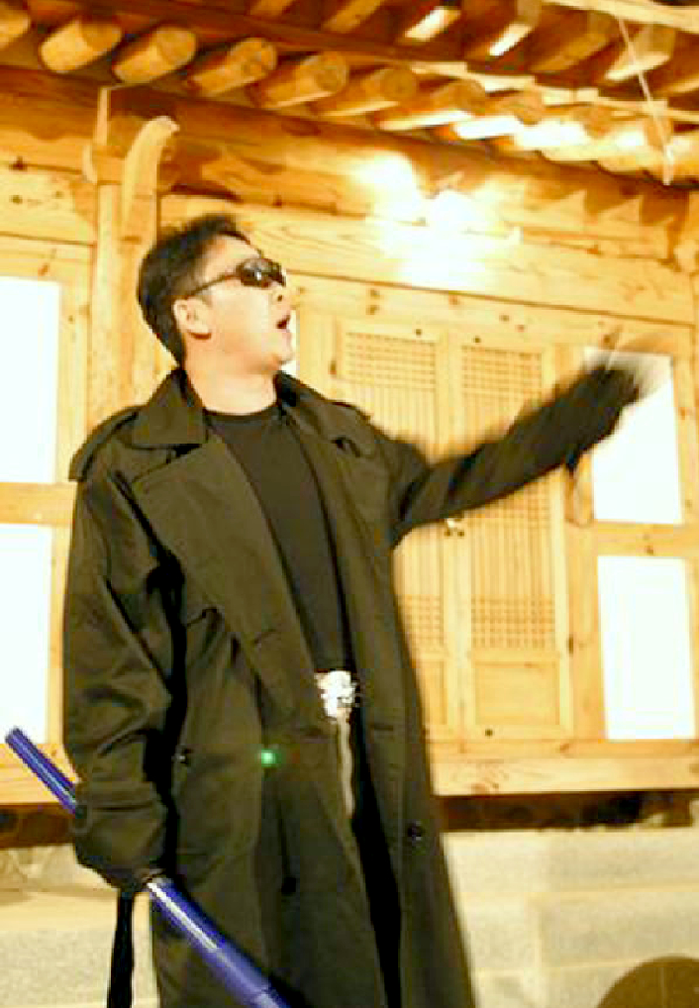
The authenticity debate
“The purpose of our league is to regain the spirit and life of p’ansori as a living art. . . . P’ansori, which used to speak for the masses, is now so detached from the life of the people it has become fossilised. . . . In order for p’ansori to be revived as a live and living art form, it is imperative that p’ansori speaks about our modern time and way of life. . . . ”
From the “Declaration of Ttorang Kwangdae”, qtd in Um p. 42–43.

Slide 11
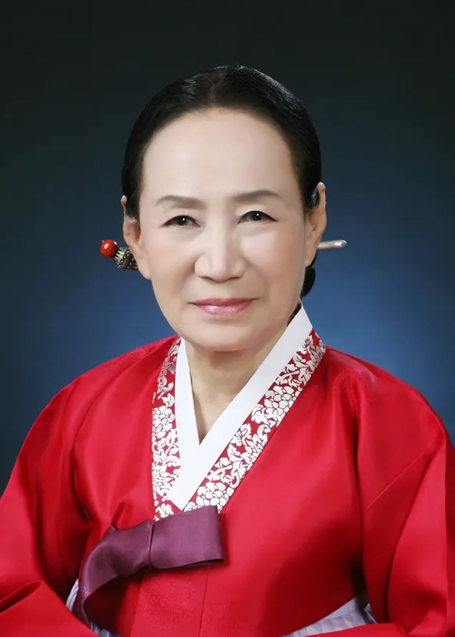
The authenticity debate
“It [new p’ansori] is an imitation not a proper p’ansori. Every p’ansori artist, even a ttorang kwangdae, should be able to sing well because singing is the most important element in this art form. It is not possible to expect everyone to love traditional p’ansori, particularly a performance of the entire story [wanch’ang] which takes so long. It is also understandable that some audiences nowadays like new p’ansori because it is easy and entertaining. But it is just a ‘wannabe,’ not a real thing. So we should not be won over by it.”
Pak Song-hŭi, qtd in Um p. 44.

Slide 12
The authenticity debate
Is debate about value of ‘traditional’ p’ansori?
Or is it differing ideas about which ‘traditions’ of p’ansori to preserve & promote?
Is p’ansori...
  Popular entertainment that ‘speaks to the masses,’ addresses contemporary issues?
    Pan, ‘gathering place,’ emphasizing community & accessibility
  Sophisticated art by those trained in a lineage, appreciated by connoisseurs?
    Sori, ‘singing,’ emphasizing technique & artistry
Can it be both? What is at stake?
  Is ‘wannabe’ p’ansori a distraction? Does ‘fossilized’ p’ansori discourage engagement?
Is there a ‘middle path’? A third position?
  Consider: Those who perform both styles, study history, promote to int’l audiences, etc.

Slide 13
Assignment details:
The “Authenticity debate” in p’ansori and beyond.
Briefly describe the two sides of ‘authenticity debate’ as summarized by Um. What is the main point/position of each side of this debate? Try to express your understanding of points addressed in this lecture, but also return to the article itself to note additional details. Can you think of another style of traditional arts where a similar debate might occur? What are the main issues at stake in the ‘authenticity debate’ about this example? What might proponents of either side of both debates learn from one another?

Slide 14
Quiz details:
Unit quiz & Module review quiz
Unit quiz:
  5 questions, ten minutes to complete.
  Focus on key ideas & arguments in Um’s article.
Module quiz:
  15 questions, 30 minutes
  Questions from all 3 units of Module
  Some based on previous Unit Quizzes, others are new
  Will include other question formats. (Matching, ordering, etc.)
  Read question instructions carefully.

Slide 15
Additional Reading
Jang, Yeonok Korean P’ansori Singing Tradition: Development, authenticity, and performance history. Scarecrow Press, 2014.
Park, Chan E. Voices from the Straw Mat: Toward an Ethnography of Korean Story Singing. Honolulu: University of Hawai‘i Press, 2003
Um, Haekyung. Korean Musica Drama: P’ansori and the Making of Tradition in Modernity. Ashgate, 2013.
(Above are the same add’l sources recommended in Unit 1. All are multi-faceted studies of p’ansori performance, including overviews of early history but with primary focus on analyzing modern and contemporary p’ansori. The article assigned for today is revised slightly for inclusion in Um 2013.)
Personal website of Seo Yoon Jang: https://www.jangseoyoon.com/

